Slide 1
Environmental change and management
Chapter 5

Slide 2
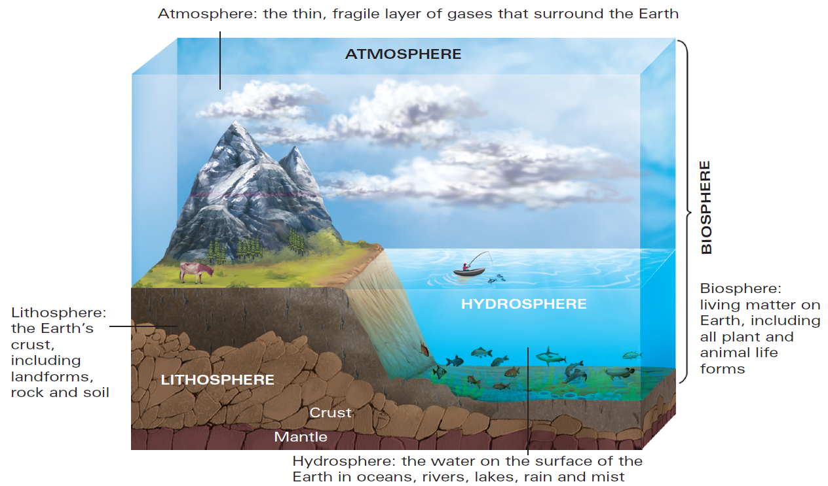
5.3 Environments
What is an environment?
Environment (in geography) is described as all the living and non-living components within and surrounding a place
Components of environments:
Biosphere
Lithosphere
Hydrosphere
Atmosphere
Habitat: the area in which an organism lives
The hydrosphere, lithosphere and atmosphere together support the biosphere

Slide 3
5.3 Environments
What is an ecosystem?: a community of living organisms that interact with the non-living components within an environment
Elements are interconnected via processes such as nutrient cycles and energy transfers (e.g. the carbon cycle)
What is biodiversity?: the variety of living things within an environment
An important measure of environmental health
Degradation: the reduction in biodiversity consequent to environmental modification or damage

Slide 4
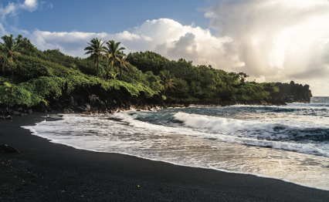
5.3 Environments
How are environments classified?
Environmental classification is based on geographic characteristics
Land: climate, elevation, topography, vegetation and soil types
Marine: water quality and depth
Human environments: can be measured by other factors such as population density
Waianapanapa Beach in Hawaii is one example of a coastal environment

Slide 5
5.4 Types of environment
Land environments: vary significantly, but most land environments can be classified as forests, deserts, grasslands or ice
Also includes inland water bodies, coastlines and highly modified rural or urban landscapes
Deserts: cover one-third of all land on Earth
Have a moisture deficit, generally receiving less than 250 mm of precipitation each year, and little to no vegetation
Sahara Desert is the world’s largest hot desert, and Antarctica is the world’s largest cold desert
Forests: environments dominated by tree cover
Complex ecosystems, containing a variety of habitats
5

Slide 6
5.4 Types of environment
Inland water environments: all water sources found on or below the land, and the landscapes that surround them (e.g. rivers, lakes, wetlands and groundwater)
Support a large variety of ecosystems in and out of the water and are critical for maintaining water quality and biodiversity
Coastal environments: the link between land and sea
Contain various components, transitioning from those typically found inland through to those usually found in marine environments
Divided into sections: offshore, nearshore, foreshore and backshore
6

Slide 7
5.4 Types of environment
Marine environments: oceans cover 71 per cent of the Earth’s surface
Seawater is the dominant and most common characteristic, but it can vary greatly (e.g. salinity, turbidity, acidity)
Variety in non-living components contributes to diversity in living components, such as corals, kelp, mangroves and seagrasses
Urban environments: contain at least 1000 people, with more than 200 people per km²
90 per cent of Australians live in urban environments
Changes must constantly occur to help the environment keep up with developments such as urban sprawl
7

Slide 8
5.5 Environmental worldviews
Environmental worldviews are shaped by personal experiences of environmental issues, media and education
It reflects the value you place on the environment – ranges from needing to protect and preserve it to utilising it for human needs
Human-centred worldview: believe humans are the most important species
The environment’s role is to provide resources to meet our unlimited needs and wants
Life-centred worldview: believe humans are stewards for the environment
We should manage our impact on the environment with sustainable choices
8

Slide 9
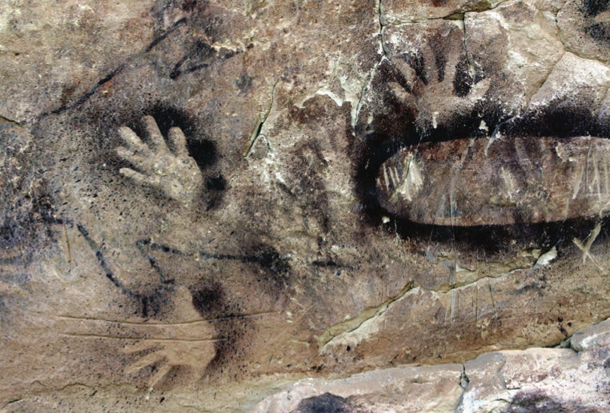
5.5 Environmental worldviews
Earth-centred worldview: humans are a part of nature
Aligns with the ideas of ecocentrism and biocentrism
The impact on environmental management: environmental worldview affect to what extent we support environmental management
The different worldviews means citizens may clash with government policies
Example of ochre cave paintings done by Indigenous Australians who are known for holding Earth-centred worldviews

Slide 10
5.6 Factors that influence environmental change
The causes of environmental change
Environments are dynamic and are constantly changing
However undisturbed environments are usually in a state of equilibrium
Human-induced changes (e.g. deforestation) can be so severe that the environment cannot recover.
These can be:
Direct changes (e.g. clearing of a forest for agricultural use)
Indirect changes (e.g. increase in population resulting in increased demand for food)
10

Slide 11
5.6 Factors that influence environmental change
Climate change
Changes in patterns of weather over extended time periods (thousands or millions of years)
Occurs naturally (ice ages), but anthropogenic (caused by humans) climate change has become increasingly prevalent and threatens the global environment
The greenhouse effect is a natural phenomenon that functions to re-radiate heat reflected from the Earth’s surface, back toward the Earth
Caused by a layer of greenhouse gases (e.g. CO₂, methane, nitrous oxide) in the atmosphere which serves to keep the Earth at a comfortable temperature
However, excess greenhouse emissions (caused by human activity) results in the enhanced greenhouse effect, causing temperatures to increase beyond what they would naturally be
11

Slide 12
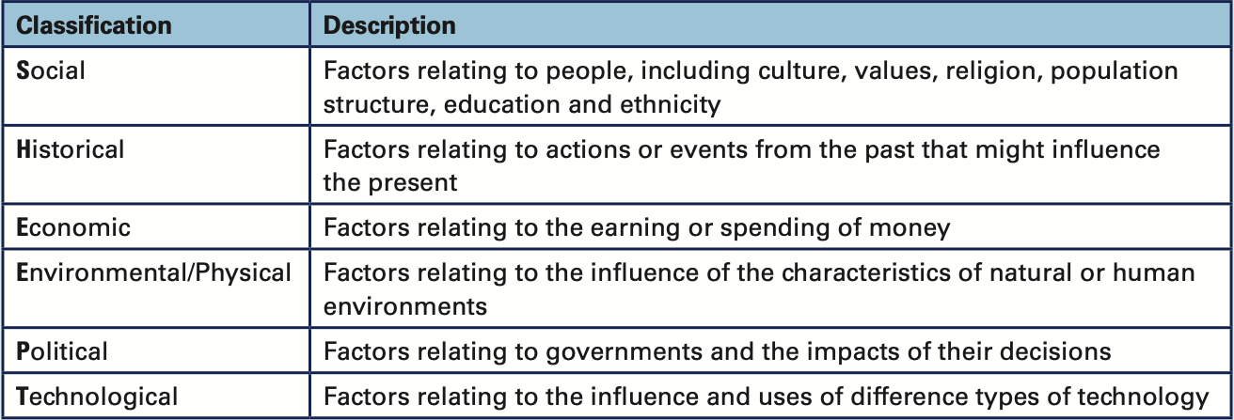
5.6 Factors that influence environmental change
Factors that influence environmental change: circumstances that contribute to or cause something to occur
can be classified using the acronym SHEEPT: social, historical, economic, environmental/physical, political and technological
12

Slide 13
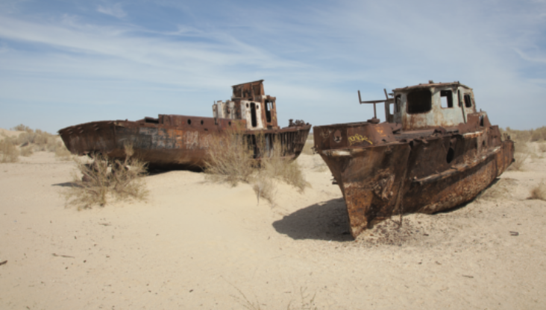
5.7 The impacts of environmental change
Impacts are classified as environmental, economic or social
The extent of impact is assessed on temporal and spatial scales
Examples of impacts of environmental change:
Land degradation (caused by activities such as deforestation): leads to impacts such as soil erosion and reduction in soil fertility
The barren wasteland of the Aral Sea is an example of desertification

Slide 14
5.7 The impacts of environmental change
Habitat fragmentation: leads to reductions in both habitat size and genetic diversity
Changing river flows and reducing water quality: used to prevent flooding of urban environments, but can negatively affect water quality
Pest and weed infestation: species that have been artificially introduced, and that negatively impact the environment
Overfishing: leads to decreased fish population and damage to marine ecosystems
14

Slide 15
5.7 The impacts of environmental change
How are impacts interconnected?
Individual impacts can lead to additional impacts within and between environments
The impacts of anthropogenic climate change: interconnected impacts such as temperature changes, rising sea levels and habitat fragmentation
Sustainability: environmental, social and economic
Whether or not an environment can maintain its current needs without compromising the needs of future generations
15

Slide 16
5.8 Evaluating management responses to environmental change
How do people respond to and manage environmental change?
A range of management responses are used to reduce the negative impacts and support the positive impacts associated with environmental change
There are also factors that determine the appropriateness, applicability and effectiveness of these responses e.g. country’s wealth, access to technology, and the extent of the environmental change being managed
Preventing change: e.g. biosecurity laws to prevent introduction of pest species, or creating national parks
Monitoring and assessment: e.g. Geographic Information Systems (GIS) such as Global Forest Watch
16

Slide 17
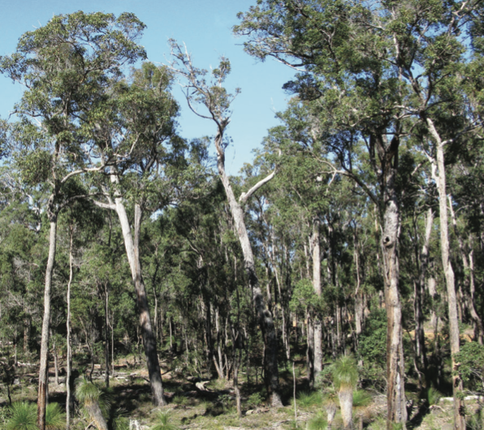
5.8 Evaluating management responses to environmental change
Reversing previous changes: e.g. returning topsoil, contour ripping and replanting of vegetation to the area
Artificial solutions: used to enable a natural process to continue within a changed environment, e.g. sea walls used to protect coastal areas from erosion
Aboriginal environmental management: using expertise from Indigenous Australians to devise sustainable means for managing environmental change, e.g. the use of controlled burns to reduce the likelihood of bushfires
The natural landscape of the Jarrah forest is coming back to the area after rehabilitation

Slide 18
5.8 Evaluating management responses to environmental change
Environmental activism: people’s worldviews play an important role in environmental management, leading to lifestyle and social changes
For instance, in 2018 the activism of Greta Thunberg, aged 15 at the time, led to a worldwide protest for action regarding climate change with 2000 simultaneous protests across 125 countries, involving over a million students
How is the effectiveness of an environmental management response measured?: a range of criteria are used to judge effectiveness
These include affordability, fairness, meeting of target outcomes, meeting of deadlines and sustainability
© Cambridge University Press 2021
18

Slide 19
5.9 Case study 5.1: the recovery of quokka populations in Western Australia
The jarrah forests of Western Australia stretch along the western edge of the Darling Plateau from Gingin in the north to Albany in the south
The forest is home to small, scattered populations of quokkas
Environmental change: the jarrah forest: the jarrah forest ecosystem is under threat from introduced predators, continued tree clearing and climate change
The impacts of change: quokka population decline: the quokka living space has been reduced from an area of 41 200km2 of the south-west of Western Australia to 17 800km2 in 1992
Land clearance, climate change and introduced predators continue to threaten the distribution and extent of quokka habitats
19

Slide 20
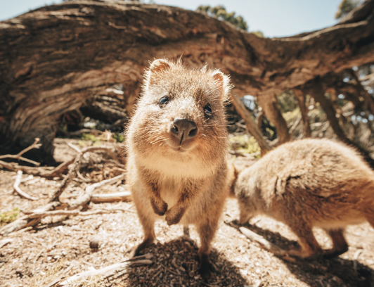
5.9 Case study 5.1: the recovery of quokka populations in Western Australia
Environmental management: Quokka Recovery Plan: 10-year recovery plan by the Western Australian Department of Environment and Conservation (DEC)
Aims to improve the conservation status of the quokka; existing populations maintain the same extent of habitat and management strategies to remove or lessen current threats
Will the Quokka Recovery Plan be effective?:
estimated to cost more than $4 million for the first five years but advantages in job creation, higher tourism
Quokka recovery plan is In place to improve the animal’s conservation status

Slide 21
5.10 Case studies in environmental management
Case study 5.2: Restoring penguin habitat on the Summerland Peninsula, Victoria
Environmental change: Summerlands Estate: Summerland Peninsula in Phillip Island had been left relatively undisturbed prior to the 1920s
In 1927, the land started being developed with the establishment of the Summerlands Estate and was subdivided into 986 residential housing blocks
The impacts of change: penguin deaths: in the 1950s it was discovered that the population of Little Penguins was falling due to the impact of urban development
Environmental management: Penguin Protection Plan: in 1985, the Penguin Protection Plan was established
Involved buying back, removing houses from, and revegetating land from the Summerlands Estate, turning it into a wildlife reserve
21

Slide 22
5.10 Case studies in environmental management
Was the Penguin Protection Plan effective?: great success in terms of hitting growth targets – the population of the local penguin colony grew from 12 000 in 1984 to a stable 36 000 in 2018
This not only benefited the environment but provided a boost to the local economy through tourism at the Penguin Parade
A negative impact was the fact that the program took 25 years instead of the expected 15, and negative social impacts on some homeowners
Nevertheless, the program was an overall success in terms of long term economic, social and environmental impacts
22

Slide 23
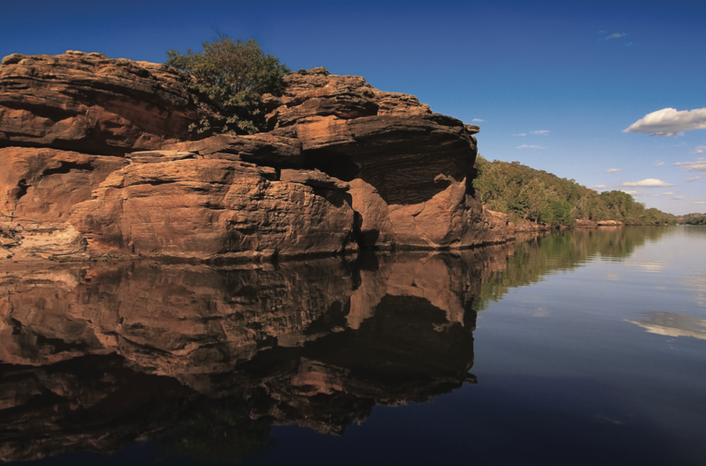
5.10 Case studies in environmental management
Case study 5.3: Using Aboriginal knowledge to manage Kakadu, Northern Territory
The Kakadu National Park (NT) is Australia’s largest national park, containing a variety of environments, and is home to many rare and endemic plants and animals
It also has a rich Indigenous cultural history stretching back 65 000 years
They have passed down their spiritual connection through generations using art, language, ceremonies, kinship and land management techniques
The East Alligator River, Kakadu, NT

Slide 24
5.10 Case studies in environmental management
Environmental change: a new fire regime: European settlement and the driving out of Aboriginal people meant that traditional fire practices decreased in frequency
The disruption of these traditional techniques spelled disaster for Kakadu’s natural environments with frequent high intensity bushfires
Environmental change: Pests and weeds: weed species and feral animals such as Asian water buffalo, cattle and cane toads were introduced
This affected the local biodiversity
Managing Kakadu: a partnership with the Bininj/Mungguy peoples: since the 1970s, half of Kakadu has been classified as Aboriginal land, and the land is now managed in a partnership between traditional owners and the Australian Government
24

Slide 25
5.10 Case studies in environmental management
Burning for biodiversity: a return to the traditional fire regime: The Burning for Biodiversity project successfully uses Aboriginal forms of land management
Reintroduction of low-intensity protective burns has led to a higher diversity in plants and birdlife
Return of food resources for local Aboriginal people, the opportunity to teach younger generations about traditional practices, and show how traditional environmental management could be applied throughout other parts of Australia
The future management of Kakadu: a delicate balance: research is still ongoing as to how best to manage Kakadu, with discussions taking place between various stakeholders
25

Slide 26
5.10 Case studies in environmental management
Case study 5.4: Monitoring and managing the Mesoamerican Reef
The Mesoamerican Reef in South America is an incredibly biodiverse ecosystem and is a huge source of revenue in terms of commercial fishing and tourism.
Environmental change: local causes: due to its topography, it is particularly susceptible to pollution flowing down from areas further inland, which has detrimental effects on the delicate ecosystem
Specifically the influx of pollution such as raw sewage and agricultural run off can lead to overgrowth of macroalgae which compete with coral
Environmental change: climate change: expected to negatively impact the reef, including coral bleaching, impaired coral growth and increased coastal erosion
26

Slide 27
5.10 Case studies in environmental management
Coastal Management Trust: insuring the reef: the Coastal Management Trust scheme was established in 2018 to protect the reef
An insurance policy that receives money from the tourism industry and uses it to finance ongoing maintenance of the reef
Healthy Reefs Initiative: assessing and monitoring the reef: a collaboration of 48 non-government organisations that monitor and evaluate the health of the reef based on a criteria
These criteria combine to give each region a score out of five, which is known as the Reef Health Index (RHI)
Between 2006 and 2016, the overall RHI has increased from 2.3 to 2.8
27

Slide 28
5.10 Case studies in environmental management
Case study 5.5: Battling land degradation in northern China.
Desertification is one of the most significant environmental challenges facing China
This is a type of land degradation in which drylands become drier until they are no longer arable (suitable for growing crops)
More than a quarter of China’s land has been affected (affecting 400 million people), mainly in the north and north-western regions
Causes of desertification in China: widespread deforestation in the 20th century, huge population growth since 1960 (currently over 1.4 billion people), unsustainable land management practices and overall climate change
The impacts of environmental change in China: dust storms and air pollution leading to health risks
28

Slide 29
5.10 Case studies in environmental management
One woman vs desertification: a local response: Yin Yuzhen started planting trees in 1985 in order to turn the desert sands in her village in Inner Mongolia into a forest
Yuzhen’s forest has created a windbreak, protecting her village from sandstorms and has halted desertification
The forest also now houses 100 species of trees and shrubs, and hosts a diverse population of animals, which has led to economic prosperity for her village
The Great Green Wall: a national response: since 1978 China has been planting billions of trees in a large-scale afforestation project
Potential to increase the world’s forest cover by 10 per cent
Success is currently mixed – although tree cover has increased, the amount of water required by young trees is a strain on the water supply, in some cases contributing to desertification
29

Slide 30
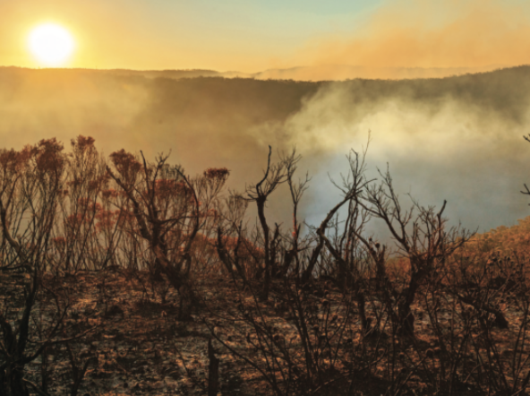
5.11 Conclusion: why does it matter?
Humans have great power and we can choose to act
Important to learn about examples of change and responses to manage the impacts of environmental change
Understand we have the power to change both our behaviour and thinking to protect what remains of our planet’s fragile ecosystems
Bushfires are a natural process but ferocious fires can lead to both short- and long-term ecological impact

